Slide 1


Nick Hörner
Stefan Mergl
Len Vejsada
Marc Siegfarth
Course: Software Engineering II
Date of presentation: 13/06/2024

Slide 2
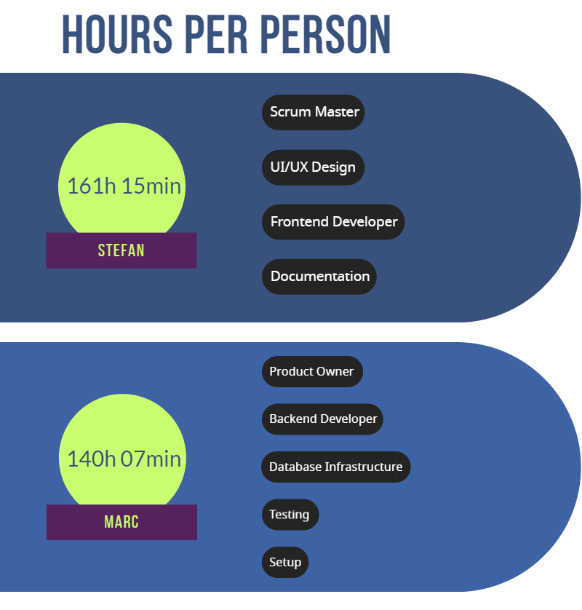
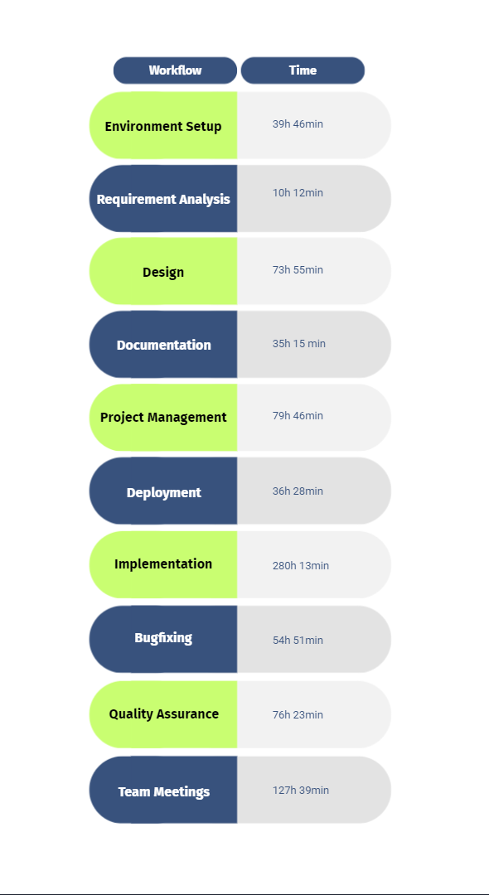
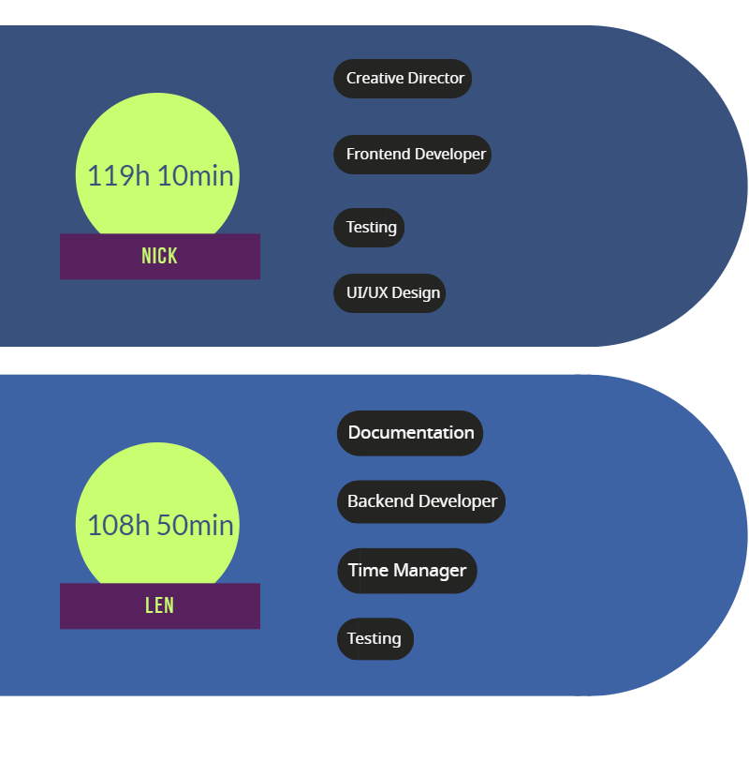
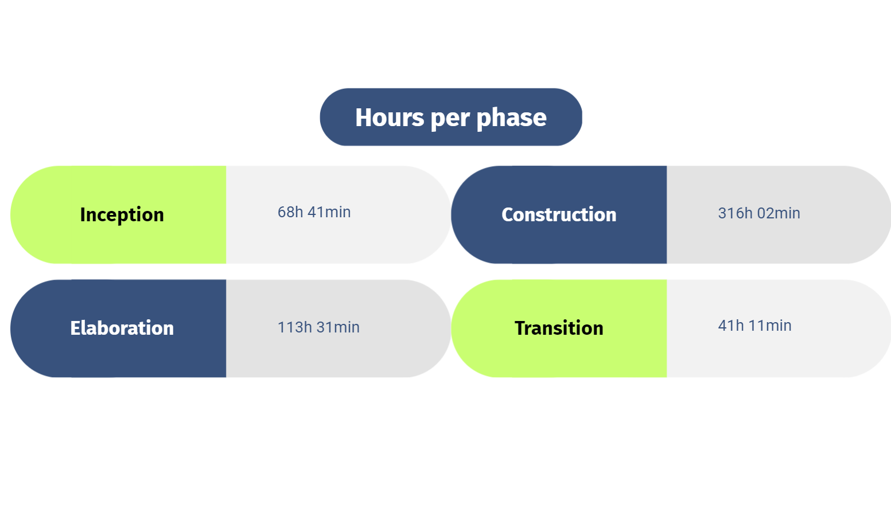
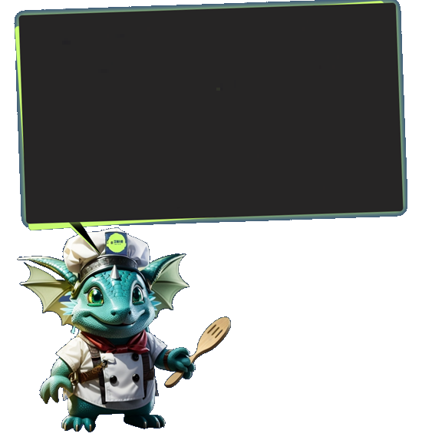
1 Statistics of efforts
Hours per workflow
Total hours spent on project:
530 h

Slide 3
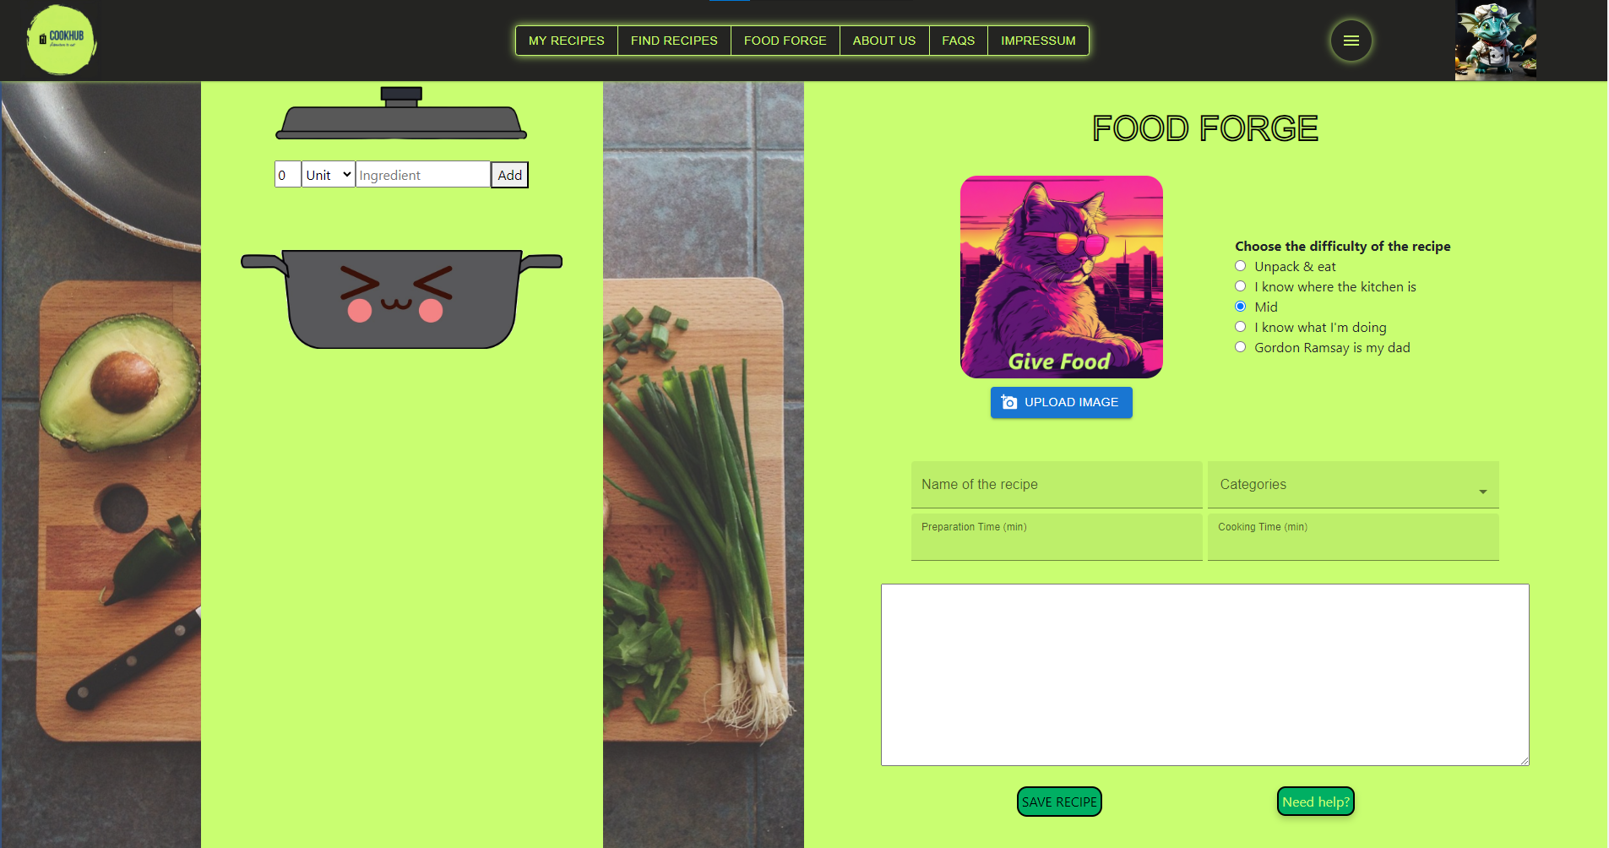
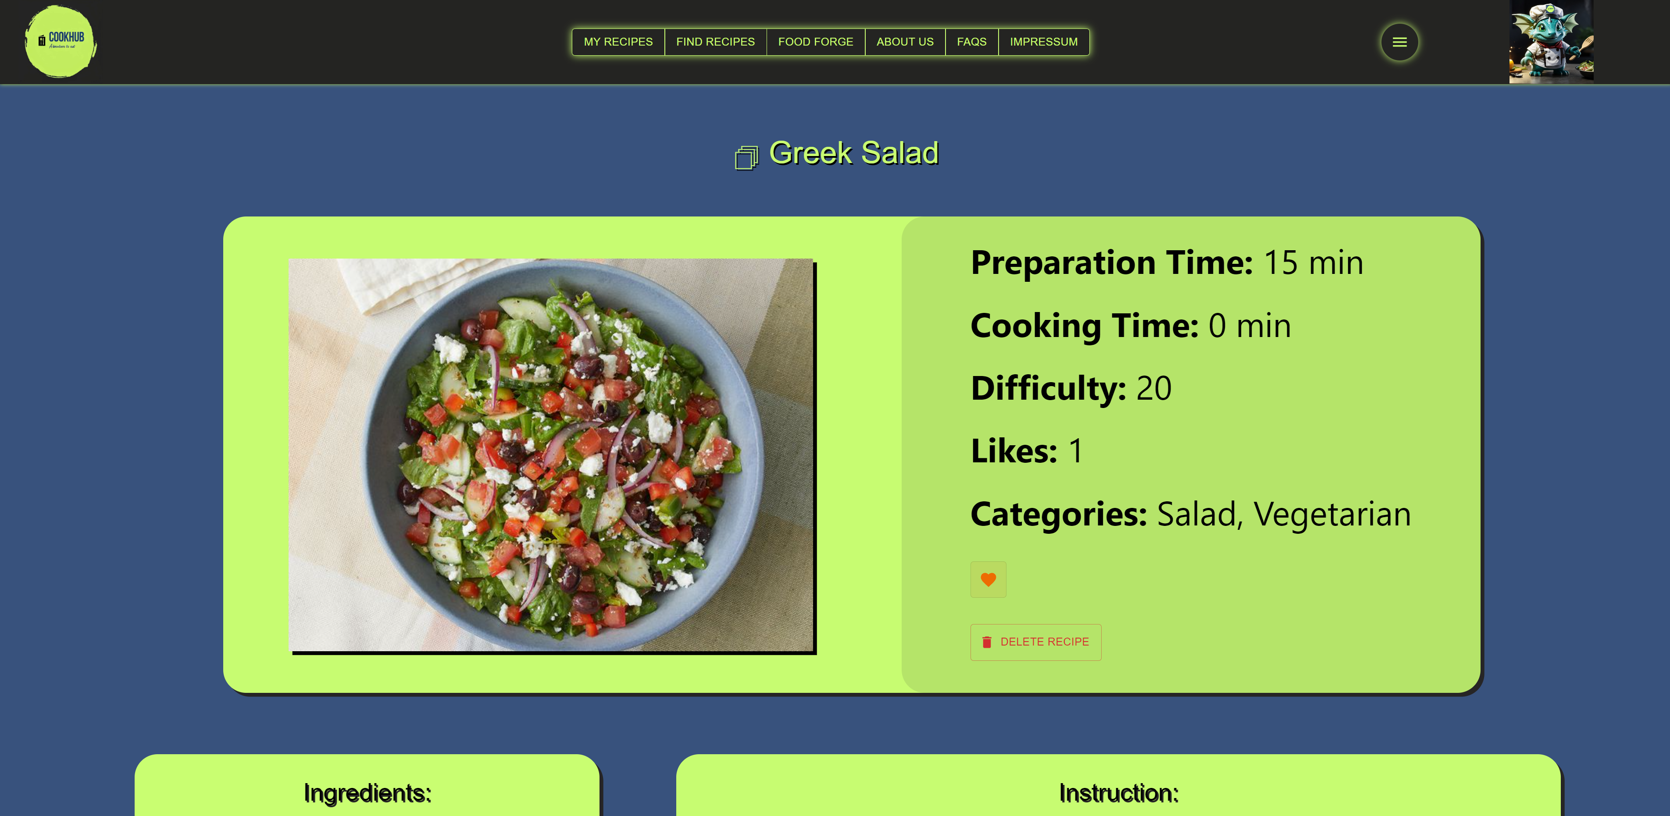
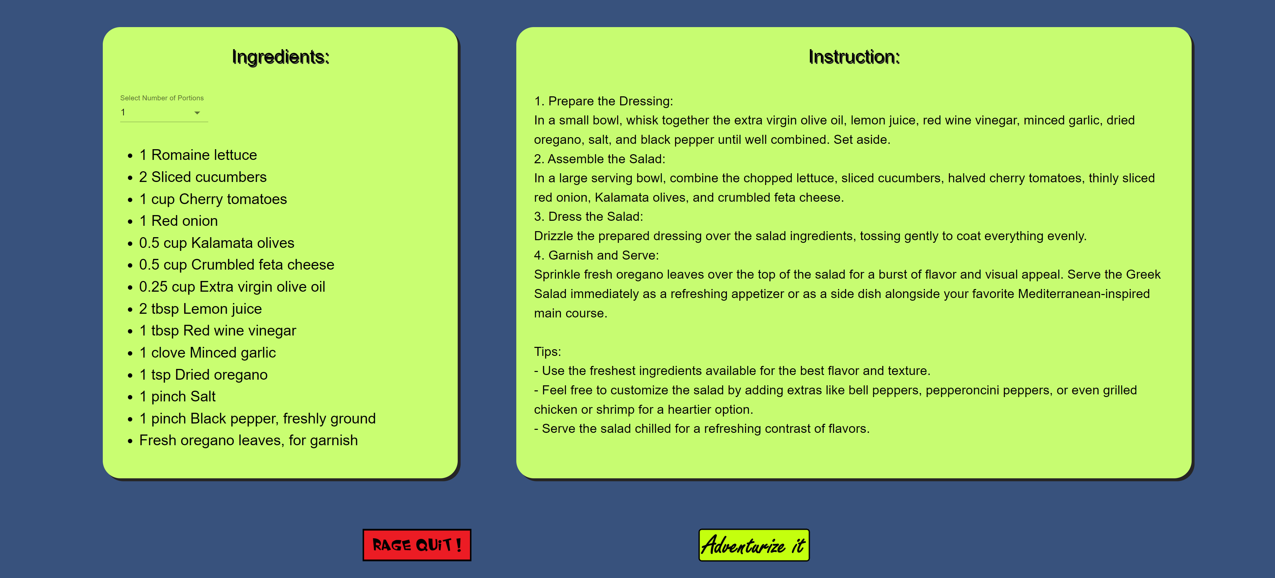
2 Demo-Highlights
FoodForge page
Forge your own recipes
Upload a picture of your recipe
Add ingredients, difficulty and categories to your recipe
Specific Recipe
Like the recipe
Delete the recipe (only own)
Ingredients will be calculated according to selected number of portions

Slide 4

2 Demo-Highlights
Adventurize it!
Turn a recipe text into an adventure
Regenerate the text if you don‘t like it
Save the best ones for you and others to see

Slide 5
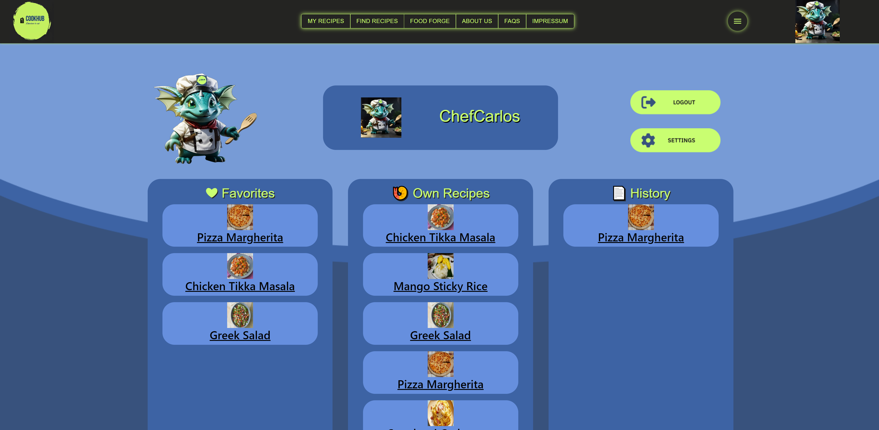
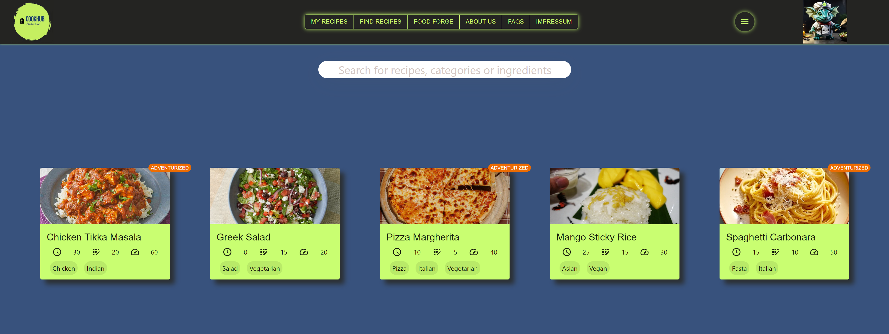
2 Demo-Highlights
Profile Page
See your recently viewed, liked and own recipes
Change username, password and profile picture
Delete account (pls don‘t)
FindRecipes Page
See a recommendation out of the most liked recipes
Search for name, category or ingredient
See recipe details in compact card view

Slide 6
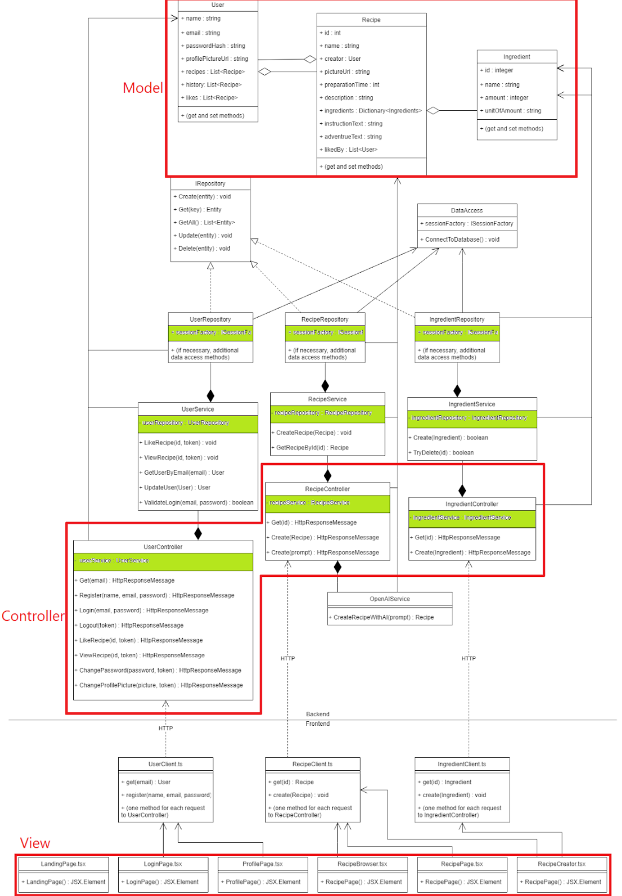
3 Project Highlights
3.1 Architecture / Design Pattern

Slide 7

MVC
Models: Classes that represent our database entities, e.g. User, Recipe, Ingredient
Views: React components that define our different web pages, e.g. LandingPage, LoginPage, RecipePage
Controllers: Backend API endpoints, which take requests by the frontend and change/transfer the requested data, e.g. UserController, RecipeController, IngredientController
Dependency inversion / Dependency Injection
The dependency inversion principle states that high-level modules should not depend on low level modules. Instead, both should depend on abstractions.
To achieve this, we decouple our classes using dependency injection: Instead of our classes creating their dependencies themselves, they only define what type their dependencies should have. The concrete instances will get passed through the constructor. This can be done by using the built-in IoC container of ASP.NET, which automatically resolves the dependencies (after a little bit of configuration).
3.2 Tech Stack
CI / CD | PM – Tools | Frontend | Backend | Database | Work Techniques
- Git - Github Actions | - Tmetric - Draw.io - Figma | - Typescript - React - Lacofy - Material UI - Jest - Selenium | - C# - ASP.NET - NHibernate - xUnit.NET - NSubstitute | - SQLite - PostregSQL | - Agile - Weeklys - Issue Tracking - Peer Review

Slide 8
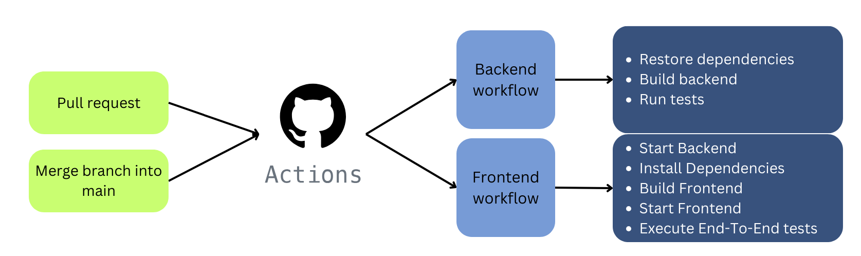
3.3 Test plan
For every newly implemented backend endpoint, there should be at least one success case and one fail case
For every newly implemented frontend functionality, there should be at least one end-to-end test (if possible) that verifies the desired behaviour
There should be integration tests for the database operations, that verfiy all CRUD operations of at least one database entity
Total number of tests: 90
30 End-To-End tests
5 Integration tests
55 Endpoint/Unit tests
3.4 Pipeline
out of 1,073 recorded workflow runs, there where:
952 successes
489 pull requests
463 pushes
117 failures
93 pull requests
24 pushes
4 canceled
4 pull requests => 87,71% success rate

